Slide 1





Client Name
This Month (Oct 01, 2016 - Oct 31, 2016) vs. previous period (Sep 01, 2016 - Sep 30, 2016)
SEARCH MANAGEMENT REPORT
Dropdown: AdWords Account
PERFORMANCE SUMMARY
18,061
985
300
520
33.5%
Impressions
Clicks
Calls
Online Conv
Impression Share
25% vs prev period
15% vs
prev period
15% vs
prev period
15% vs
prev period
15% vs prev period
ROLLING 6 MONTH ANALYSIS
Date | Spent | Impressions | Visits | CPC | CTR | Calls | Other Conv | Total Conv | CPL | Conv Rate | Ave Page Position
1-Oct-2016 – 31-Oct-2016 | $1500 | 18,061 | 985 | $1.52 | 0.89% | 300 | 50 | 350 | $6.99 | 8.00% | 3.5
1-Sep-2016 – 30-Sep-2016 | $1500 | 18,061 | 985 | $1.52 | 0.89% | 300 | 50 | 350 | $9.99 | 8.00% | 3.5
1-Aug-2016 – 31-Aug-2016 | $1500 | 18,061 | 985 | $1.52 | 0.89% | 300 | 50 | 350 | $4.99 | 8.00% | 3.5
1-Jul-2016 – 31-Jul-2016 | $1500 | 18,061 | 985 | $1.52 | 0.89% | 300 | 50 | 350 | $5.99 | 8.00% | 3.5
1-June-2016 – 30-Jun-2016 | $1500 | 18,061 | 985 | $1.52 | 0.89% | 300 | 50 | 350 | $7.99 | 8.00% | 3.5
1-May-2016 – 31-May-2016 | $1500 | 18,061 | 985 | $1.52 | 0.89% | 300 | 50 | 350 | $6.99 | 8.00% | 3.5
Totals & Average | $9000 | 108,336 | 5910 | $1.52 | 0.89% | 1800 | 300 | 2100 | $9.99 | 8.00% | 3.5
TOP 10 KEYWORD PHRASES
CLICKS BY DEVICE USAGE
COST PER LEAD
# | Keyword | Clicks | Impressions
1 | Hyundai i30 | 300 | 5,552
2 | Hyundai i30 | 300 | 5,552
3 | Hyundai i30 | 300 | 5,552
4 | Hyundai i30 | 300 | 5,552
5 | Hyundai i30 | 300 | 5,552
6 | Hyundai i30 | 300 | 5,552
7 | Hyundai i30 | 300 | 5,552
8 | Hyundai i30 | 300 | 5,552
9 | Hyundai i30 | 300 | 5,552
10 | Hyundai i30 | 300 | 5,552

Slide 2
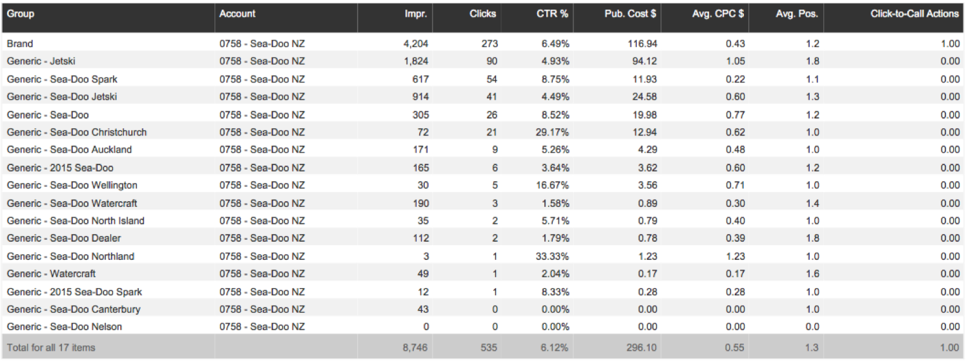
Client Name
This Month (Oct 01, 2016 - Oct 31, 2016) vs. previous period (Sep 01, 2016 - Sep 30, 2016)
SEARCH MANAGEMENT REPORT
Dropdown: AdWords Account
CAMPAIGN SUMMARY
Calls

